Slide 1
Hospital Emergency – Room Triage System
Team No - 06
U. Bruhathi — 2620030025
M. Harshitha Reddy — 2620030118
1 - Immediate
2 - Emergent
3 - Urgent
4 – Less Urgent
5 – Non-Urgent

Slide 2
Abstract
Hospital Emergency Room Triage System — Abstract
The Hospital Emergency Room Triage System is a software application designed to streamline and automate the initial patient assessment, prioritization, and assignment process in a hospital emergency department. Traditional paper-based triage methods often lead to delays, human error, and difficulty in tracking patient urgency, which can compromise critical care delivery. This system provides a centralized platform to efficiently classify patients based on medical severity and manage emergency room workflows.
The system enables medical staff to register incoming patients, record vital signs, assign triage priority levels (e.g., Immediate, Urgent, Non-Urgent), and track waiting times. It maintains real-time records of patient status, bed availability, and attending staff assignments. Healthcare providers can search for patient records, update medical statuses, and identify critical cases requiring immediate intervention.
By automating routine intake and prioritizing care based on medical necessity, the proposed system reduces admission delays, minimizes manual record errors, saves crucial time, and improves patient outcome tracking. It provides an organized, reliable method for monitoring emergency room capacity and generating operational reports. The Hospital Emergency Room Triage System can be implemented as a Java application and further enhanced with features like real-time vital monitor integration, automated SMS alerts for family members, queue time estimation algorithms, and role-based access for doctors and nurses. Overall, the system aims to deliver a fast, structured, and user-friendly solution for managing emergency care activities.

Slide 3
Understanding Problem Statement
The problem
Our solution
1. Emergency rooms receive more patients than can be treated at once.
2. Manual triage depends on judgement, so decisions can be slow and inconsistent.
3. Critical patients risk waiting behind less serious cases.
1
Capture
Nurse enters age and vital signs at the console
2
Score
Rules turn each reading into severity points
OBJECTIVE
3
Classify
Build a rule-based Java program that ranks arriving patients by urgency so the most critical are seen first.
Total score maps to triage level 1 to 5
4
Prioritise
Queue is ordered so critical cases come first

Slide 4
Module 1 (CO 1): Java Foundation
Module 1 Topics | Where it appears in the triage system
Algorithm & Flowchart | Triage steps planned as a flowchart before code is written
Structure of a Java program | Class TriageSystem with public static void main(String[] args)
Data Types, variables, constants | int age, double temperature, Boolean such as 38.6, ‘Y’ and true
Identifiers & Literals | heartRate, patientName; literals such as 38.6, 'Y' and true
Operators | Arithmetic, relational & logical, ternary, and bitwise (alert flags)
Typecasting & expressions | (double) totalWait / count for average wait; precedence in score formulas
Console I/O | Scanner reads the vitals; printf prints an aligned triage report

Slide 5
Module 1 (CO 1) : Flowchart & Code
Start
Read age & vitals
Compute severity score
Score >= 9
Else-if Level 2-5
Add to queue
End
Level 1 : Immediate
Variables, constants & operators
final int MAX_PATIENTS = 50;
int heartRate = 118, spo2 = 92;
double temp = 38.6;
int score = 0;
score += (heartRate > 110) ? 2 : 0;
if (temp >= 38 && spo2 < 94) score++;
double avg = (double) totalWait / count;
Console I/O with Scanner & printf
Scanner sc = new Scanner(System.in);
System.out.print("Patient name: ");
String name = sc.nextLine();
System.out.print("Heart rate (bpm): ");
int heartRate = sc.nextInt();
System.out.printf("%-10s Score:%2d Level:%d%n", name, score, level);

Slide 6
Module 2 (CO 2): Selection
Five triage levels
If-else-if ladder, nested if, switch
if (score >= 9) level = 1;
else if (score >= 6) level = 2;
else if (score >= 4) level = 3;
else if (score >= 2) level = 4;
else level = 5;
// nested if: safety override
if (spo2 < 90) {
if (!conscious) level = 1;
}
switch (level) {
case 1: label = "IMMEDIATE"; break;
case 2: label = "EMERGENT"; break;
default: label = "STANDARD";
}
1
Level 1: Immediate
Score 9 or more | seen at once
2
Level 2: Emergent
Score 6 to 8 | target 10 min
3
Level 3: Urgent
Score 4 to 5 | target 30 min
4
Level 4: Less Urgent
Score 2 to 3 | target 60 min
5
Level 5: Non-Urgent
Score 0 to 1 | target 120 min

Slide 7
Module 2 (CO 2): Iteration
While loop
Main menu repeats until the nurse chooses Exit.
while (choice != 0) {
showMenu();
}
Do-while loop
Ask for heart rate at least once; repeat until valid.
do {
hr = sc.nextInt();
} while (hr < 20 || hr > 250);
For loop
Traverse the waiting list and print each patient.
for (int i = 0; i < n; i++) {
print(queue[i]);
}
Continue
Skip patients who are already discharged.
for (int i = 0; i < n; i++) {
if (done[i]) continue;
print(queue[i]);
}

Slide 8
Module 3 (CO 3): Methods
Methods
static int calcScore(int hr, int spo2, double temp) {
int score = 0;
// ... rules add points ...
return score;
}
int score = calcScore(118, 92, 38.6);
// overloading: same name, diff params
static void print(String name, int level) { }
static void print(String name, int level, int wait) { }
Each method does one job. Overloading lets print() serve both quick and detailed reports.

Slide 9
Module 3 (CO 3): 1D Arrays
int[ ] waitTimes = {12, 45, 8, 30, 22}; // minutes
12
45
8
30
22
Index starts at 0, so length is 5 and the last index is 4.
117 Sum (min)
23.4 Average (min)
45 Longest wait
1 Waits over 30 min

Slide 10
Module 3 (CO 3): 2D Arrays & Matrices
Day 1 Arrivals
Day 2 Arrivals
 | L1 | L2 | L3 | L4 | L5
Morning | 1 | 3 | 6 | 8 | 4
Evening | 2 | 4 | 7 | 9 | 5
Night | 1 | 2 | 5 | 4 | 2
 | L1 | L2 | L3 | L4 | L5
Morning | 0 | 4 | 5 | 7 | 6
Evening | 1 | 5 | 8 | 6 | 3
Night | 2 | 1 | 4 | 5 | 1
Total = Day1 + Day2
 | L1 | L2 | L3 | L4 | L5
Morning | 1 | 7 | 11 | 15 | 10
Evening | 3 | 9 | 15 | 15 | 8
Night | 3 | 3 | 9 | 9 | 3

Slide 11
Module 4 (CO 4) : Classes & Objects
Class, fields & constructors
Patient is a blueprint; each arrival is an object.
class Patient {
private String name; private int age, level;
Patient(String name, int age) {
this.name = name; this.age = age; }
Patient(String name) { this(name, 0); }
}
Patient p = new Patient("Asha", 34);
Encapsulation
Private fields; access only through methods
public int getLevel() { return level; }
public void setLevel(int level) {
if (level >= 1 && level <= 5)
this.level = level;
}
// invalid levels are rejected
Static members & constants
Shared by the whole class, not one patient.
static int totalPatients = 0;
static final int MAX_LEVEL = 5;
static int getTotal() {
return totalPatients;
}
// constructor: totalPatients++;
toString() & null references
Readable output for reports and the queue.
@Override
public String toString() {
return name + " (L" + level + ")";
}
Patient next = null;
if (next != null) print(next);

Slide 12
Module 4 (CO 4): Inheritance & Exceptions
Inheritance & overriding
CriticalPatient "is-a" Patient with extra rules
class CriticalPatient extends Patient {
@Override
public String toString() {
return "URGENT: " + super.toString();
}
}
Interface
Programming to an interface, not a class.
interface Triageable {
int calcScore();
}
class Patient implements Triageable { }
Triageable t = new CriticalPatient(..);
try-catch-finally & multi-catch
Bad input must not crash the ER system.
try { hr = Integer.parseInt(s); }
catch (NumberFormatException |
NullPointerException ex) {
System.out.println("Invalid input");
} finally { System.out.println("Done"); }
Throw & throws
Checked vs unchecked exceptions
static void check(int hr)
throws InvalidVitalsException {
if (hr < 20 || hr > 250)
throw new InvalidVitalsException("HR");
}
// unchecked: ArithmeticException

Slide 13
Module 5 (CO 5): Strings
Core String operations
Strings are immutable; a new String is returned.
String n = " asha rao ".trim();
n.length(); n.charAt(0);
n.substring(0, 4);
n.toUpperCase();
n.contains("rao"); n.indexOf('r');
Equals() vs ==
Compare values, never references.
String a = "Asha";
String b = new String("Asha");
a == b; // false (reference)
a.equals(b); // true (value)
a.equalsIgnoreCase("ASHA"); // true
StringBuilder
Mutable text for building the triage report.
StringBuilder sb = new StringBuilder();
sb.append(name).append(" L").append(level);
sb.append('\n');
sb.insert(0, "> ");
String report = sb.toString();
Split(), join() & validation
Parse a record line into fields
String line = "Asha,34,118,92,38.6";
String[] f = line.split(",");
int age = Integer.parseInt(f[1].trim());
if (f.length != 5) { /* malformed */ }
String out = String.join(" | ", f);

Slide 14
Module 5 (CO 5): Sorting & File I/O
Comparable & Comparator
Order the queue: level first, then wait time
class Patient implements Comparable<Patient> {
public int compareTo(Patient o) {
return Integer.compare(level, o.level);
}
}
Comparator<Patient> byWait =
Comparator.comparingInt(Patient::getWait);
Sort & binary search
Library algorithms, no hand-written sort.
Arrays.sort(waitTimes);
Collections.sort(list);
Collections.sort(list, byWait);
int pos = Arrays.binarySearch(
waitTimes, 30); // array must be sorted
Read & write files
Save patients using java.nio.file.
Path p = Path.of("patients.csv");
List<String> lines = Files.readAllLines(p);
Files.writeString(p, rec + "\n",
StandardOpenOption.APPEND,
StandardOpenOption.CREATE);
Try-with-resources & bad records
Missing file or bad line never stops the run
try (BufferedReader br =
Files.newBufferedReader(p)) {
String ln;
while ((ln = br.readLine()) != null) {
if (ln.split(",").length != 5) continue;
}
} catch (IOException ex) { /* no file */ }
.

Slide 15
Module 6 (CO 6): Collections & Generics
ArrayList<Patient>
Typed list: the compiler blocks wrong types.
List<Patient> queue = new ArrayList<>();
queue.add(new Patient("Asha", 34));
queue.remove(0);
queue.get(0); queue.size();
for (Patient p : queue) print(p);
HashMap: patient lookup
Find a patient by ID in one step.
Map<Integer, Patient> byId = new HashMap<>();
byId.put(101, p);
Patient f = byId.get(101);
byId.containsKey(101);
for (var en : byId.entrySet()) { }
HashSet & ordered TreeMap
No duplicates; keys kept sorted.
Set<String> allergies = new HashSet<>();
allergies.add("Penicillin"); // no repeats
Map<Integer, Integer> perLevel =
new TreeMap<>();
perLevel.merge(level, 1, Integer::sum);
Autoboxing & iterators
int and Integer convert automatically.
List<Integer> waits = new ArrayList<>();
waits.add(45); // autoboxing
int w = waits.get(0); // unboxing
Iterator<Patient> it = queue.iterator();
while (it.hasNext()) {
if (it.next().done) it.remove(); }

Slide 16
Module 6 (CO 6): Lambdas & Streams
Lambdas & functional interfaces
Pass behaviour as a parameter.
Predicate<Patient> critical = p -> p.level == 1;
Function<Patient, String> nm = Patient::getName;
Consumer<Patient> show = p -> print(p);
Supplier<Patient> blank = () -> new Patient("?");
Stream pipeline
Declarative processing of the queue.
queue.stream()
.filter(critical)
.sorted(byWait)
.limit(3)
.map(Patient::getName)
forEach(System.out::println);
Terminal operations
Summaries in a single line.
long n = queue.stream().filter(critical).count();
int total = waits.stream()
.reduce(0, Integer::sum);
List<String> names = queue.stream()
.map(Patient::getName).distinct().toList();
Collectors & file streams
Build shift reports from data.
Map<Integer, Long> perLevel = queue.stream()
.collect(Collectors.groupingBy(
Patient::getLevel, Collectors.counting()));
String s = queue.stream().map(Patient::getName)
.collect(Collectors.joining(", "));
Files.lines(p).forEach(System.out::println);

Slide 17
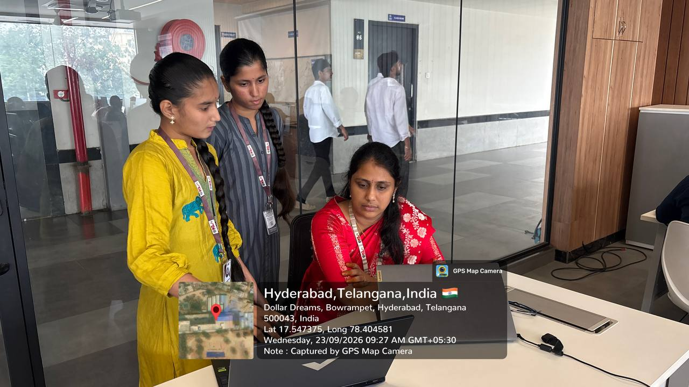
Geo Tag Photo and git hub link
https://github.com/bruhathi0920
https://github.com/maddhikaharshithareddy

